Slide 1

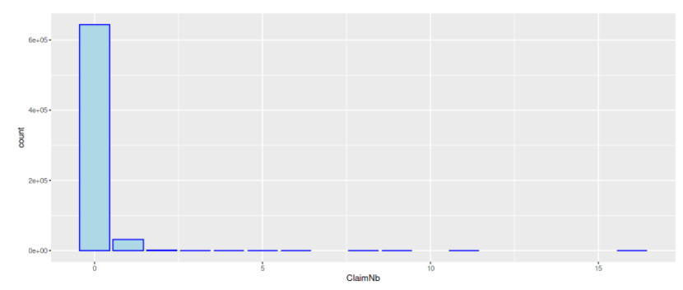
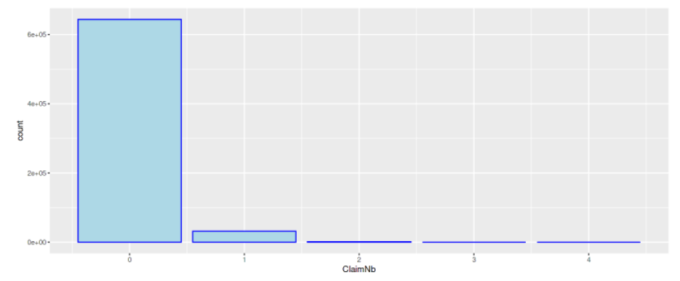
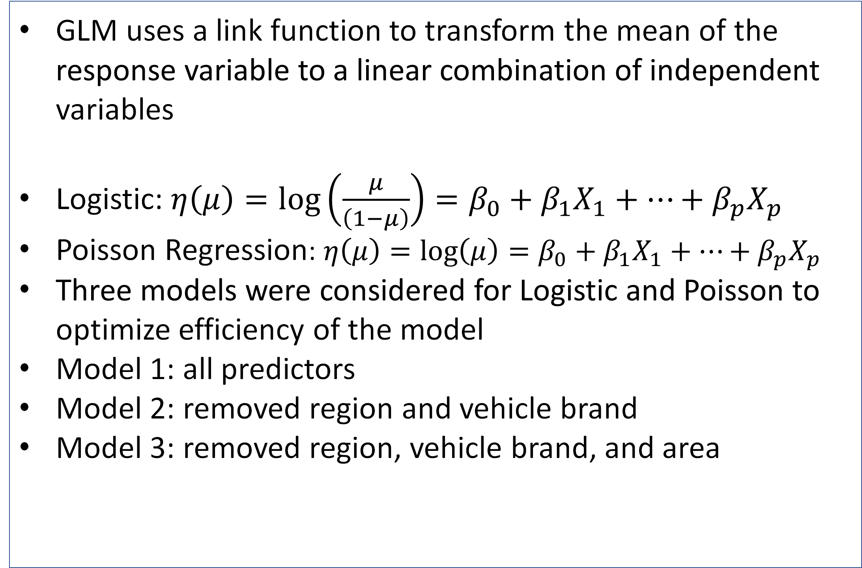
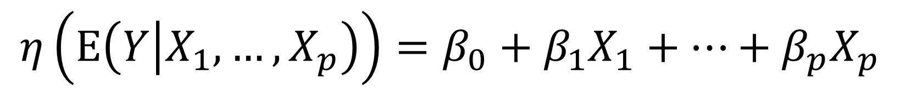
GLM Models for Car Insurance Claims
Jimmy Lagese, Derek Miller, Madi Ricciuti, Nikitas Missos
Advised by: Dr. Moon Nguyen and Dr. Thomas Wakefield
Youngstown State University, Youngstown, OH
Abstract
Visual Displays
Accuracy of Models
Insurance companies are always seeking the most accurate and efficient way to predict future insurance claims. A plethora of research has been done studying various statistical models. Our project aims to predict the numbers of claims that people will make for their car insurance per year using a general linearized model (GLM). We will examine multiple characteristics of a driver and his or her vehicles to determine which variables will be used to predict the number of claims.
​ | Model 1​ | Model 2​ | Model 3​
Poisson RMSE​ | 0.00010841 | 0.00008137 | 0.000077516​
Binomial RMSE​ | 0.000207796 | 0.00019321 | 0.0001907​
From all the Root Mean Squared Errors we see that they are all very small indicating that our model is making accurate predictions. As we optimize the significant factors, we see that we improve our model each step with Model 3 of the Poisson being the best
Methodology
Conclusions
Risk features and claim numbers were collected for 677,991 motor liability policies
Take all input variables and relevel them to 5 classes from 0-4 of the number of claims​
Divide the data into training and testing sets (80% training, 20% testing)​
The predictors considered are Vehicle Power, Vehicle Age, Bonus Malus, Vehicle Brand, Gas, Density (population), Region, Area, Driver Age​
Model​ 3​ | 0​​ | 1​​ | 2​​ | 3​​ | 4​​
0​​ | ​128733​ | ​6453​ | ​347​ | 15​ | 3​​
1​​ | ​70​ | 22​​ | 5​ | ​0​ | 0​​
From the best model, it is accurately predicting the number of claims 94.918% of the time
Most of our correct predictions come when zero claims are observed
As the number of claims increase our model struggles to maintain accuracy due to the mass number of observations with zero claims
Mathematical Models
GLM uses a link function to transform the mean of the response variable to a linear combination of independent variables
Logistic: $η\left(μ\right)=\log\left(\frac{μ}{\left(1−μ\right)}\right)=β_{0}+β_{1}X_{1}+…+β_{p}X_{p}$
Poisson Regression: $η\left(μ\right)=\log\left(μ\right)=β_{0}+β_{1}X_{1}+…+β_{p}X_{p}$
Three models were considered for Logistic and Poisson to optimize efficiency of the model
Model 1: all predictors​
Model 2: removed region and vehicle brand​
Model 3: removed region, vehicle brand, and area
Distribution of Claims
$$η\left(Ε\left(Y | X_{1},…,X_{p}\right)\right)=β_{0}+β_{1}X_{1}+…+β_{p}X_{p}$$
ClaimNb | 0 | 1 | 2 | 3 | 4
n | 643953 | 32178 | 1784 | 82 | 16
Future Works
Continue to look into ways to accurately predict the higher number of claims
Analyze the effects of underpredicting the number of claims
References :
“French Motor Claims Datasets” Kaggle.com, Kaggle.com, 1 Jan 2019, www.Kaggle.com
James, G., Witten, D., Hastie, T., & Tibshirani, R. (2021). An introduction to statistical learning with applications in R. Springer.

